Slide 1

Employee Data Analysis
Using Microsoft Excel

Slide 2
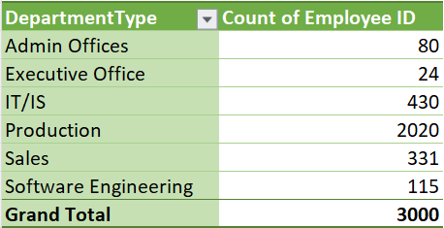
1. Can you create a pivot table to summarize the total number of employees in each department?

Slide 3
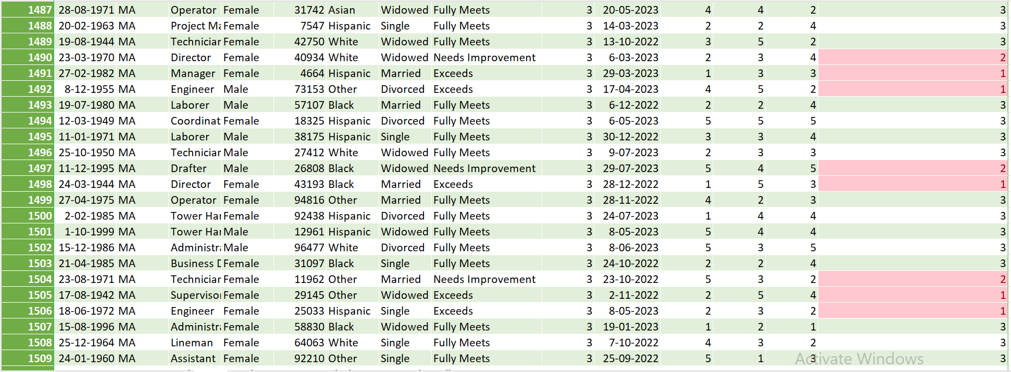
2. Apply conditional formatting to highlight employees with a "Performance Score" below 3 in red.
For applying conditional formatting to highlight employees with “Performance Score” below 3. I was created a new column whose name is “Performance Score in Numbers” which having Performance Score in number. Fully Meets replaced with 3, Needs Improvement replaced with 2, Exceeds replaced with 1 and PIP replaced with 0. For doing all the changes, I used “if” formula.
=IF(Performance Score = "Fully Meets", 3, IF(Performance Score = "Needs Improvement", 2, IF(Performance Score = "Exceeds", 1, IF(Performance Score = "PIP", 0, "NA"))))

Slide 4
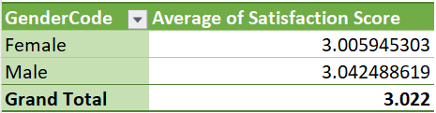
3. Calculate the average "Satisfaction Score" for male and female employees separately using a pivot table.

Slide 5
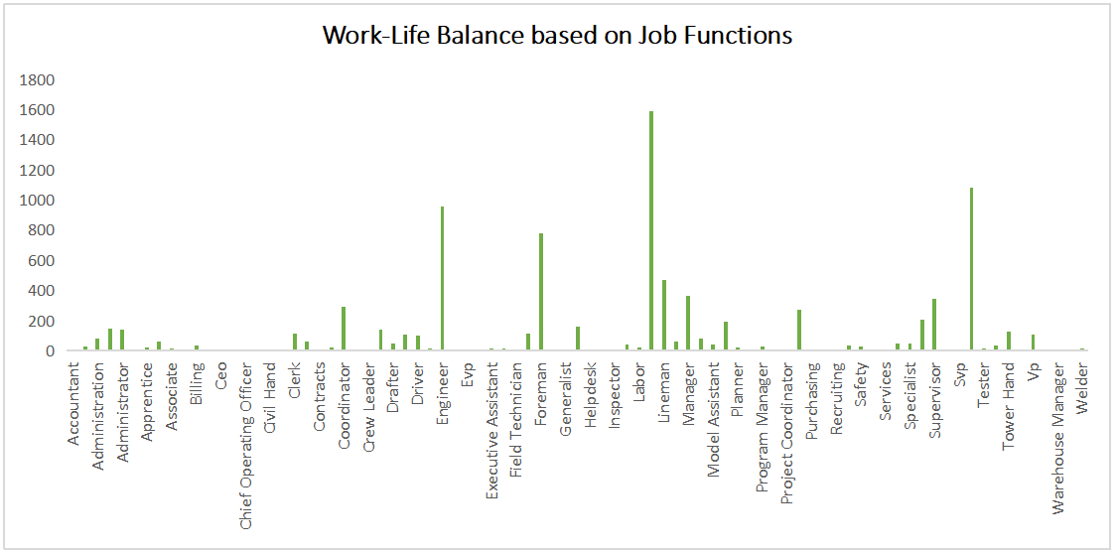
4. Create a chart to visualize the distribution of "Work-Life Balance Score" for different job functions.

Slide 6
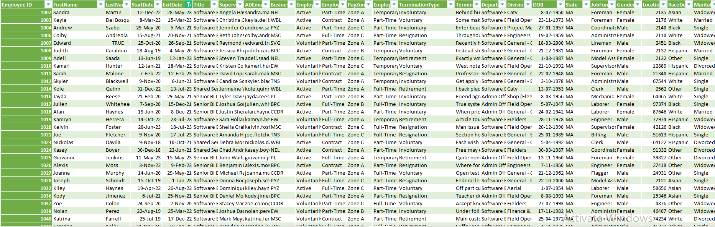
5. Filter the data to display only terminated employees and find out the most common "Termination Type."
Following the below steps for filtering the data to display only Terminated Employees :-
Go to Data Tab => Click on Filter => Select the column header arrow => Select all Dates except Blanks and select OK.

Slide 7
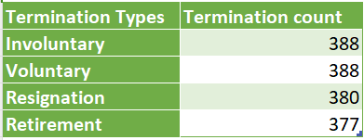
Following the below formula to find out the most common Termination Type :-
“=countif(range, criteria)” for counting individual terminated type and I found that Involuntary and Voluntary are the most common Terminated Type

Slide 8
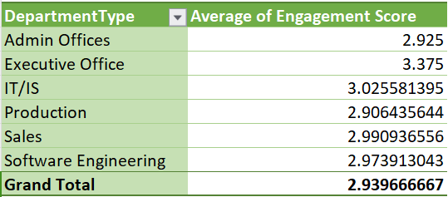
6. Calculate the average "Engagement Score" for each department using a pivot table.

Slide 9
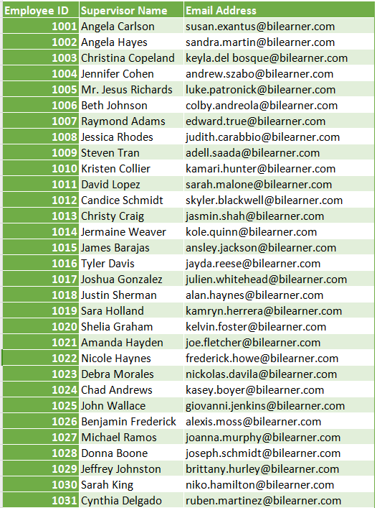
7. Use VLOOKUP to find the supervisor's email address for a specific employee.

Slide 10
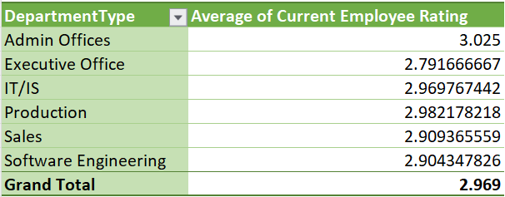
8. Can you identify the department with the highest average "Employee Rating?"
For finding, average highest “Employee Rating” I was created a Pivot Table which having Department Type and average of Current Employee Rating with their desending order. After that, I found Admin offices have the highest average “Employee Rating”.

Slide 11
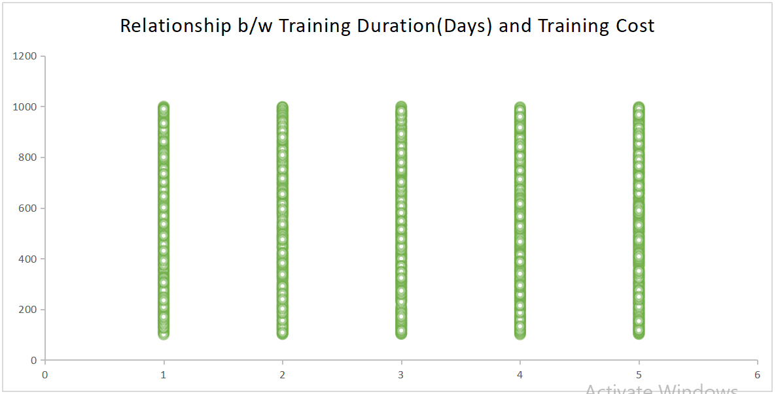
9. Create a scatter plot to explore the relationship between "Training Duration (Days)" and "Training Cost."

Slide 12
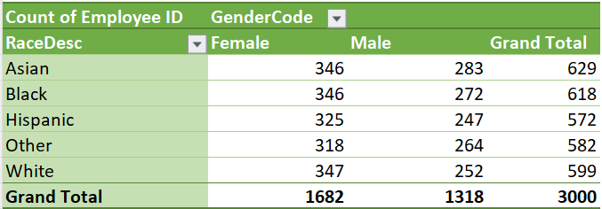
10. Build a pivot table that shows the count of employees by "RaceDesc" and "GenderCode."

Slide 13
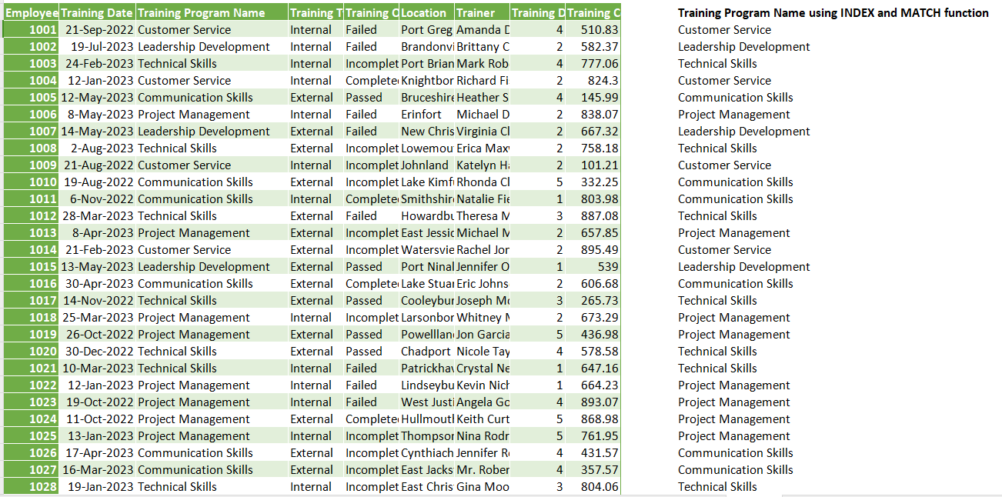
11. Use INDEX and MATCH functions to find the "Training Program Name" for an employee with a specific ID.

Slide 14
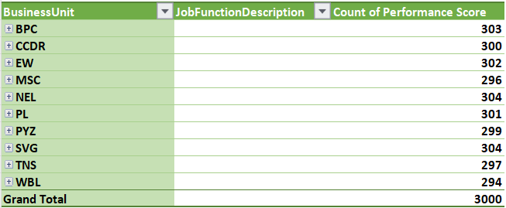
12. Create a multi-level pivot table to analyze the "Performance Score" by "BusinessUnit" and "JobFunctionDescription."

Slide 15
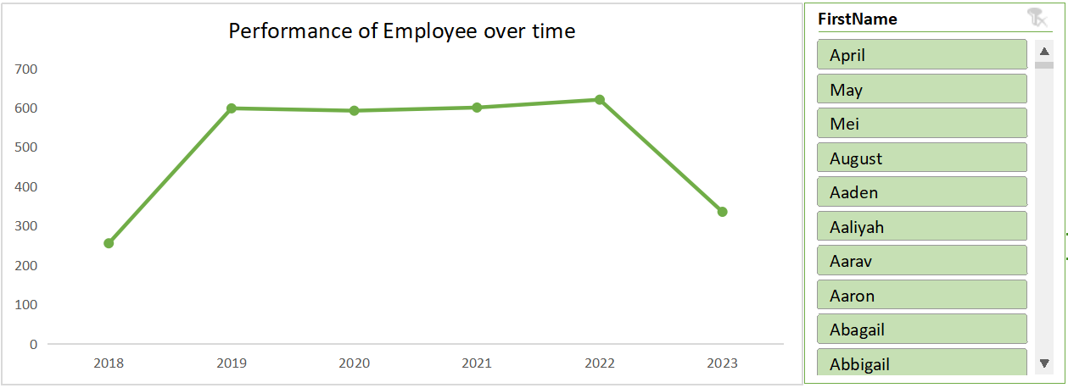
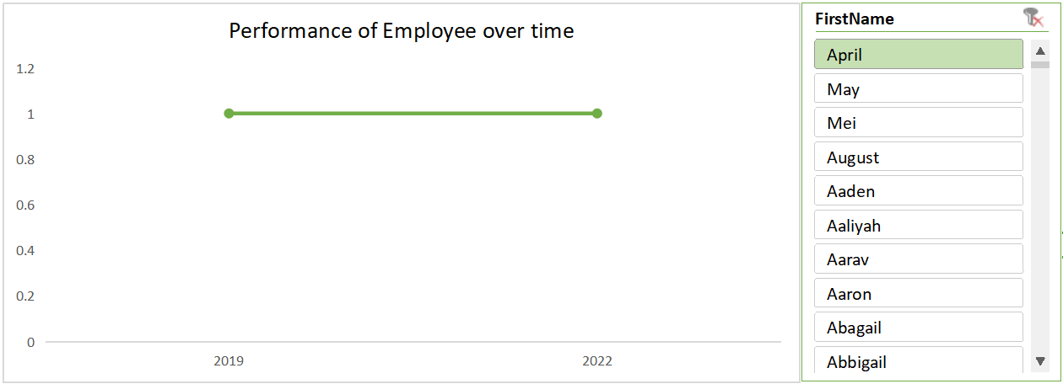
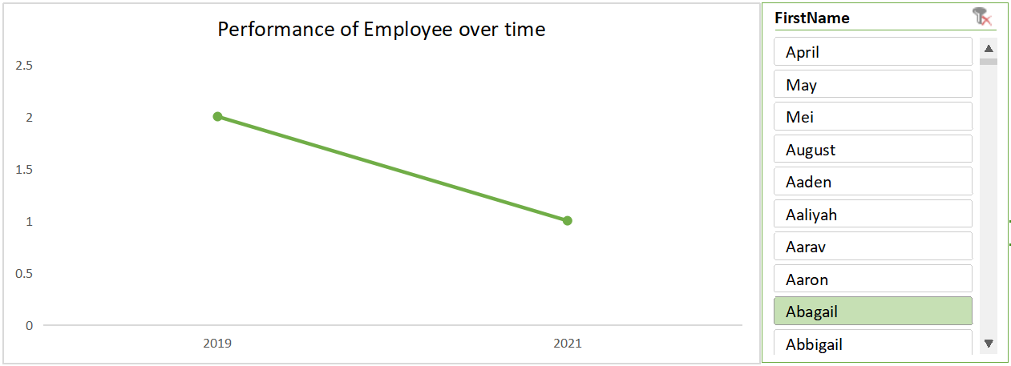
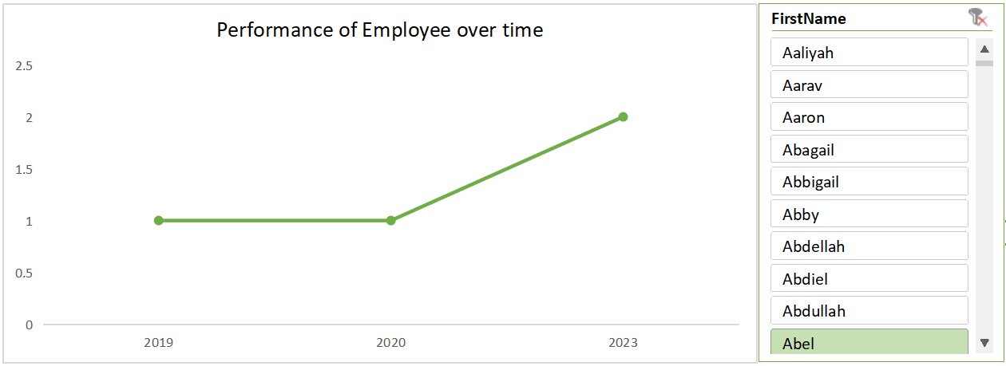
13. Design a dynamic chart that allows users to select and visualize the performance of any employee over time.

Slide 16
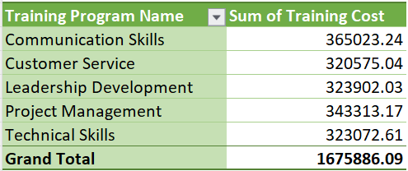
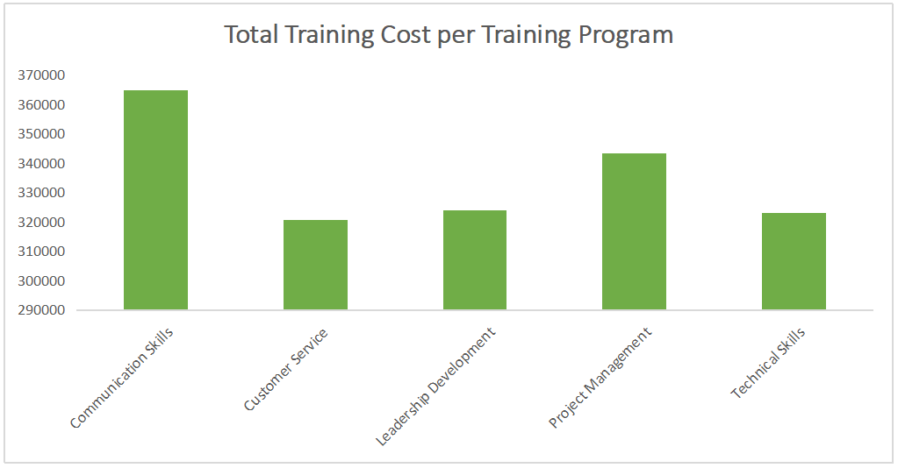
14. Calculate the total training cost for each "Training Program Name" and display it in a bar chart.

Slide 17
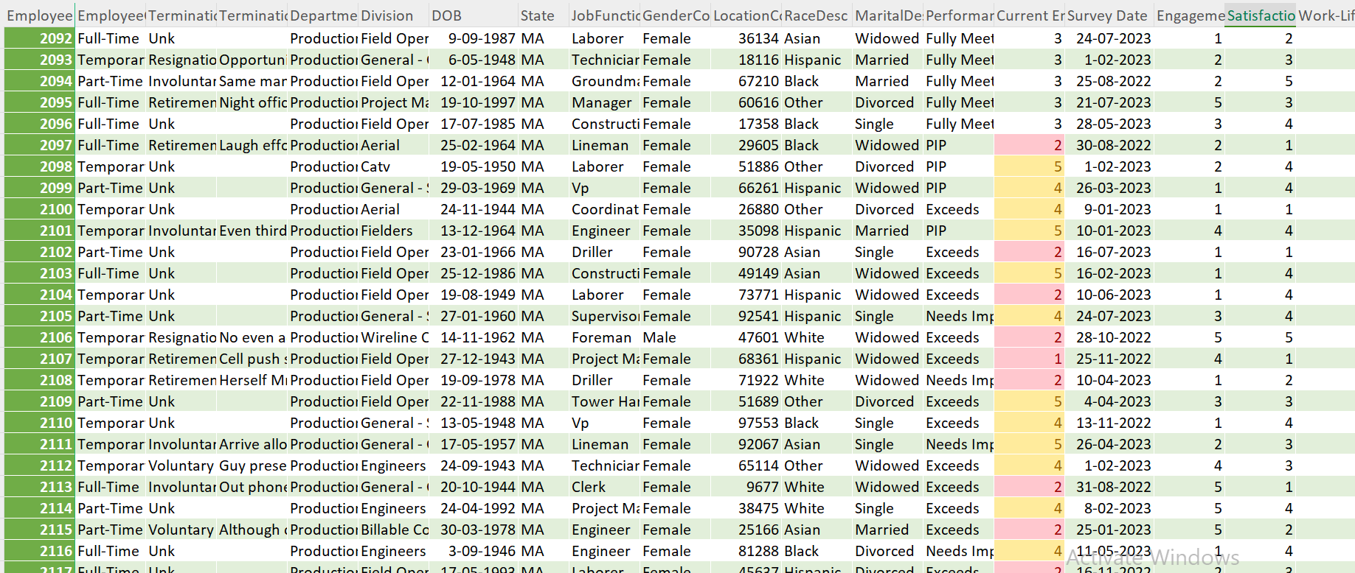
15. Apply advanced conditional formatting to highlight the top 10% and bottom 10% of employees based on "Current Employee Rating."

Slide 18
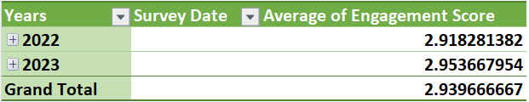
16. Use a calculated field in a pivot table to determine the average "Engagement Score" per year.

Slide 19
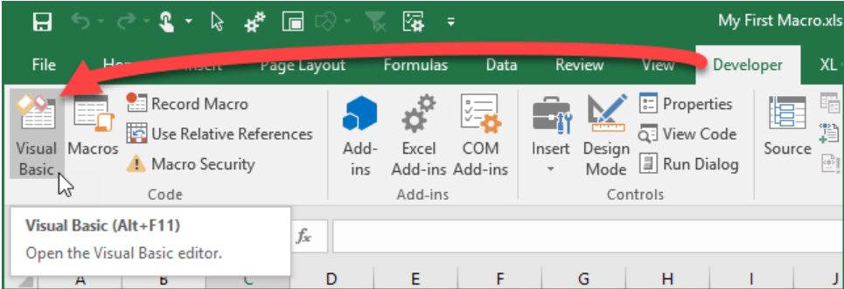
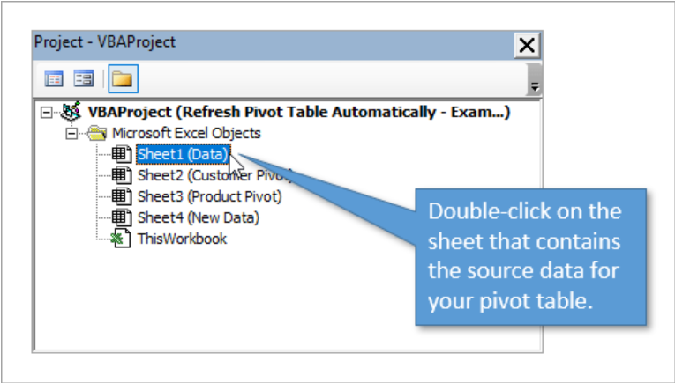
17. Can you build a macro that automates the process of updating and refreshing all pivot tables in the workbook?
When we insert a Pivot Table in the sheet, Pivot Table data does not change itself once the data changes. So, we need to do it manually. But in VBA, there is a statement to refresh the Pivot table. Using this, we can refresh the Pivot Table by referencing the worksheet or refer to the entire Pivot Tables in the worksheets and refresh them all at once.
Below are the steps to do that :-
1. Open the Visual Basic Editor.
2. Open the Sheet Module that contains the source data.

Slide 20
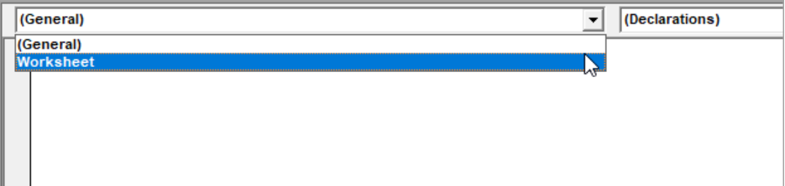
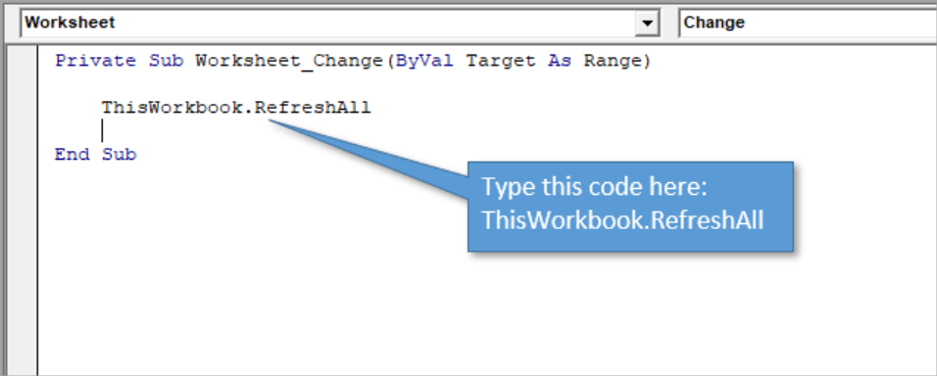
3. Add a new event for worksheet changes.
Double-clicking on the sheet opens up the code module for that object. Worksheet_SelectionChange event to the module. We need to delete that event. After that go to the procedure drop down menu and select change. New event add at the top and we need to delete unnecessary code from there. Then we will add VBA code to the Worksheet_Change event to perform actions.
4. Add the VBA code to refresh all pivot tables.
The RefreshAll method will refresh all the pivot tables, queries, and data connections in the workbook.

Slide 21
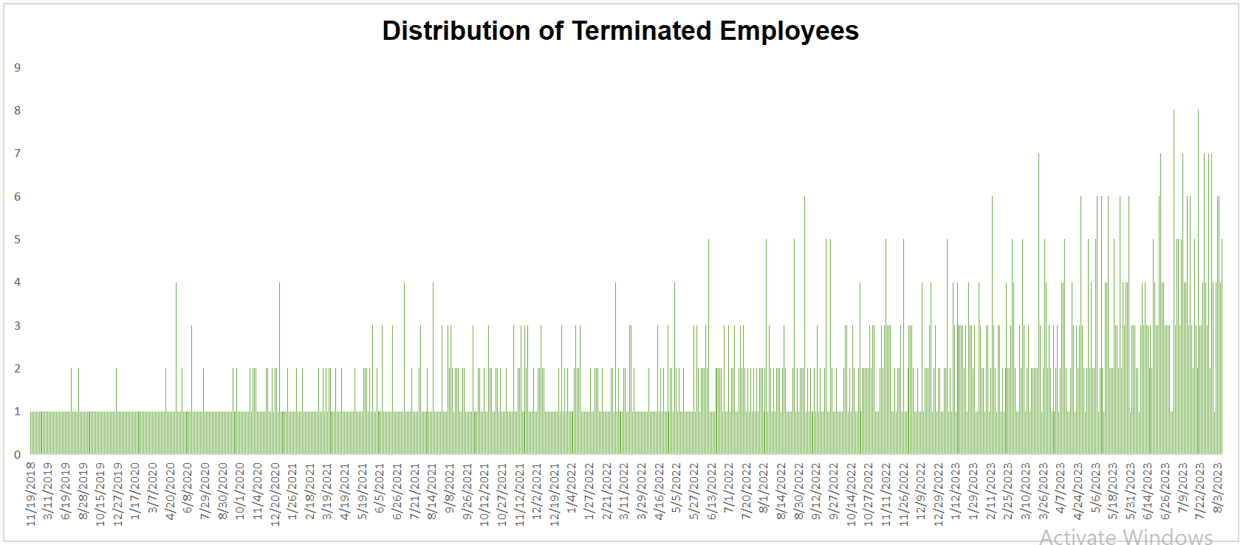
18. Create a histogram to understand the distribution of "ExitDate" for terminated employees.

Slide 22
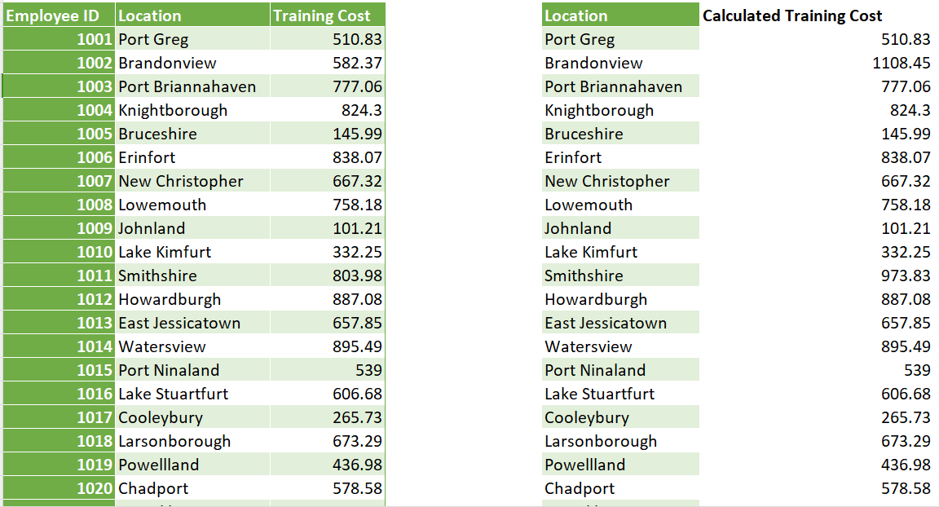
19. Utilize the SUMPRODUCT function to calculate the total training cost for employees in a specific location.

Slide 23
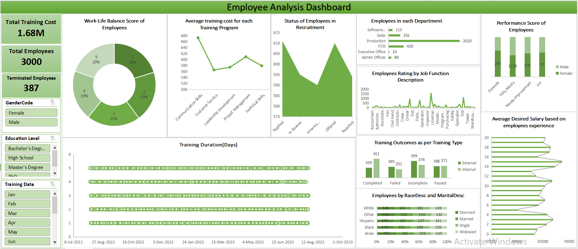

Slide 24


